Slide 1
ICTNWK541 Assessment
Assessment Task 2: Project Portfolio
Manuel Sergio Perez Espitia

Slide 2
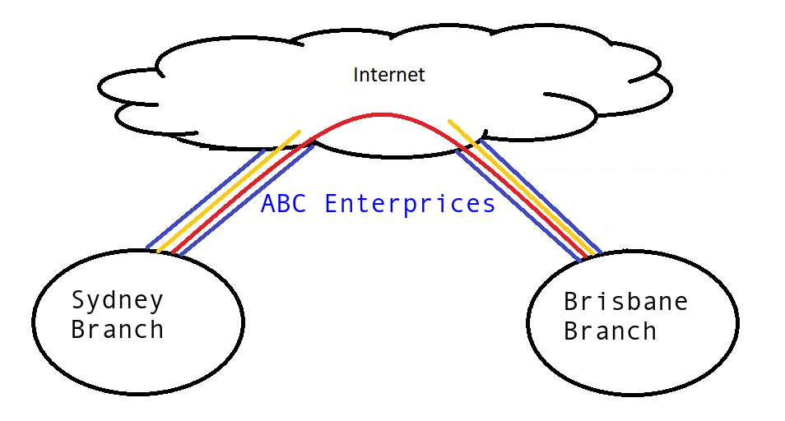

Slide 3

We are the network engineer responsible for implementing the required WAN connectivity for ABC Enterprises.
ABC Enterprises wants to improve its network due to old infrastructure, security and reliability WAN connectivity between Sydney Branch and Brisbane Branch.

Slide 4
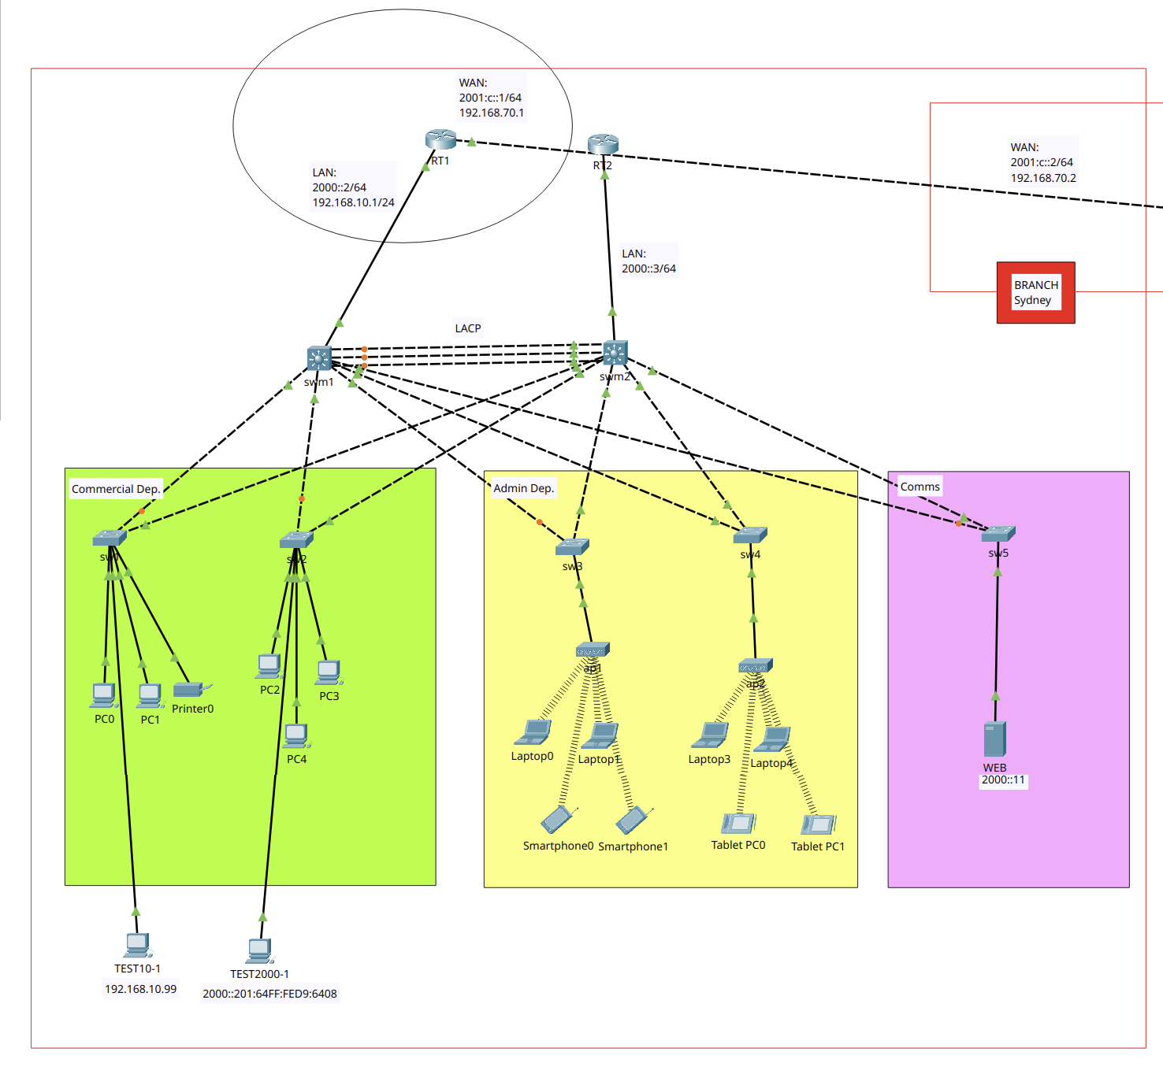
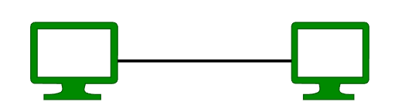
Sydney Branch

Slide 5
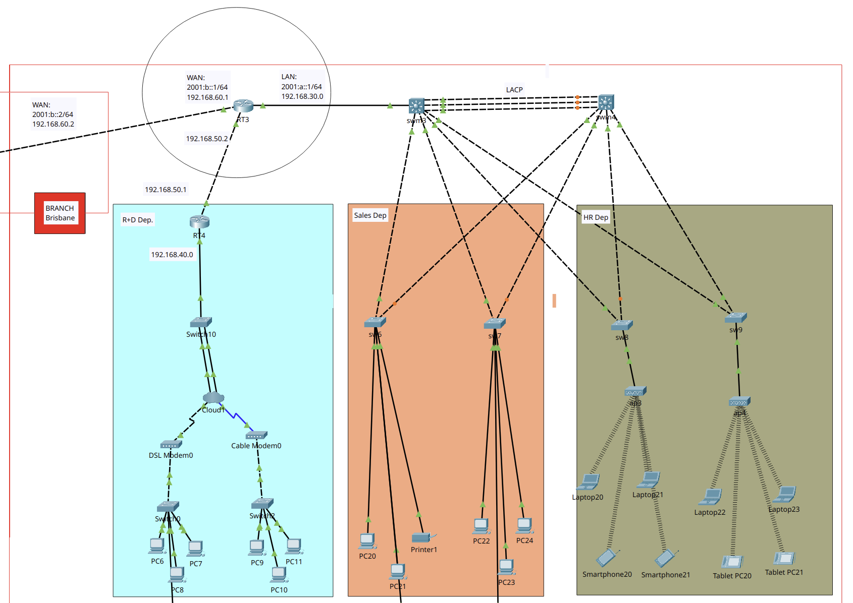
Brisbane Branch

Slide 6

Simulation Software & Tools
Cisco Packet Tracer 8.2.2
Ubuntu 24.04 LTS
Wireshark 4.2.2

Slide 7
Network Details
Sydney Branch
Type: LAN/WAN
Topology: Dual-Star high availability
Architecture: 3-Tier
Brisbane Branch:
Type: LAN/WAN
Topology: Dual-Star high availability
Architecture: 2-Tier

Slide 8
Network Nodes
Sydney |  | Brisbane
2 (HA) | Routers | 2
5 | Switches | 5
2 (HA) | Switches L3 | 2 (HA)
1x1x0 | Servers, Printers, Modems | 0x1x2
13 | End Devices | 19

Slide 9

Content
Legal & security: Policies and Procedures
WAN Configuration and Troubleshooting & Testing
Summary Technologies & Protocols

Slide 10
Legal & security: Policies and Procedures

Slide 11

Legal & security
ABC Enterprises adopts security technologies to ensure data protection. The company's policies are outlined below.

Slide 12

Legal & security
Service Password Encryption
Policy to prevent access to plain-text passwords in network devices.
ISO/IEC 27001

Slide 13

Legal & security
Mandatory Login Password
Policy on all network devices that requires a login password for any access to routers or switches.
NIST SP 800-53 (IA-2)

Slide 14


Legal & security
VPN Site-to-Site
Policy implements IPSec to protect data in transit between different company branches over internet.
NIST SP 800-77

Slide 15

Legal & security
Access Control Lists (ACLs)
Policy to filter traffic and control access between subnets, enhance internal network security.
ISO/IEC 27002 (s13)

Slide 16

Legal & security
Secure Remote Access to infrastructure
Policy to protect remote access by Telnet and SSH to network devices using password-protected and encrypted.
NIST SP 800-5

Slide 17
WAN Configuration
Installation Plan

Slide 18
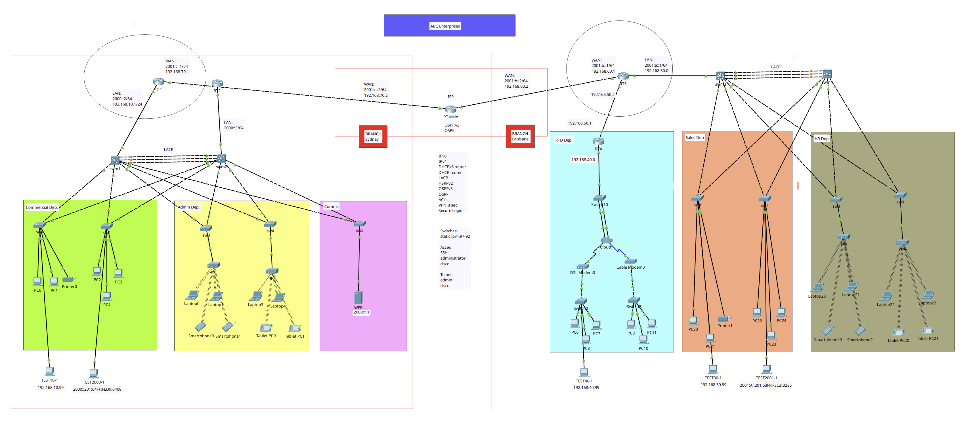
Network

Slide 19
WAN Configuration
Secure Access by SSH & Telnet
Additional Protocols: DHCP
Additional Protocols: LACP
Additional Protocols: HSRP
Additional Protocols: OSPF
WAN protocols: ACL
WAN Protocols: VPN
WAN Protocols: PPP
Dynamic NAT
Firewall Single-port
Logging Network

Slide 20
Troubleshooting & Testing
Local

Slide 21
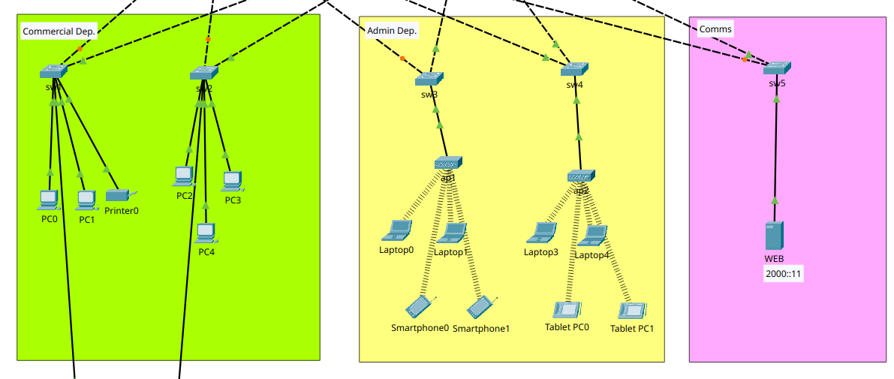
Sydney Branch

Slide 22
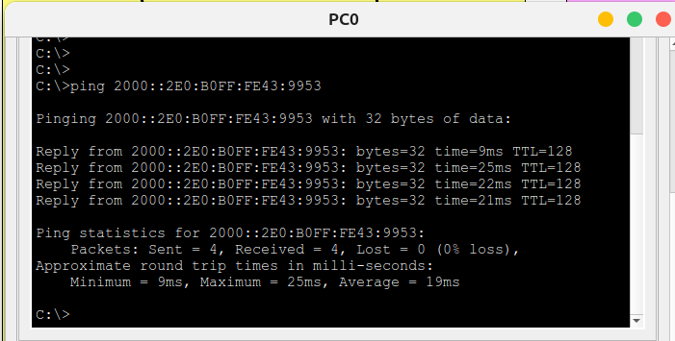
Sydney Branch - Local
Commercial and Admin over IPv6PC0 LAPTOP0

Slide 23
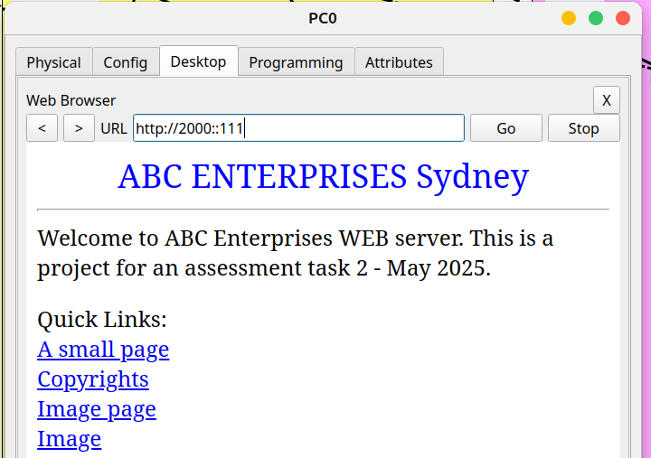
Sydney Branch - Local
Commercial and Comms over IPv6
WEB PC0

Slide 24
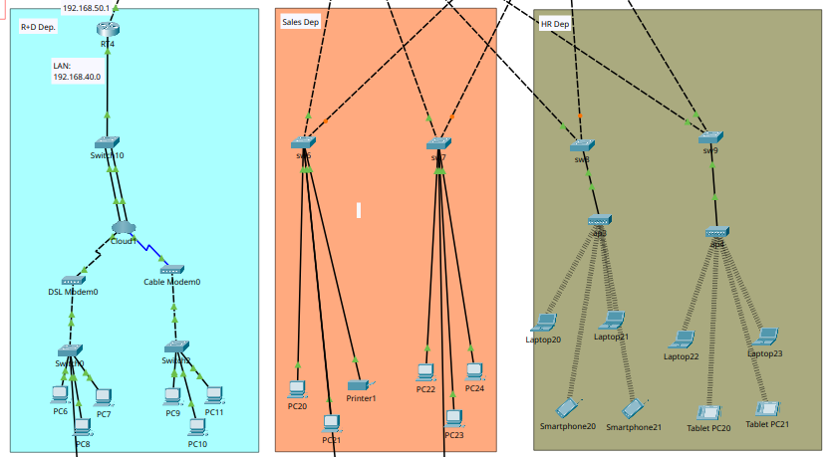
Brisbane Branch

Slide 25
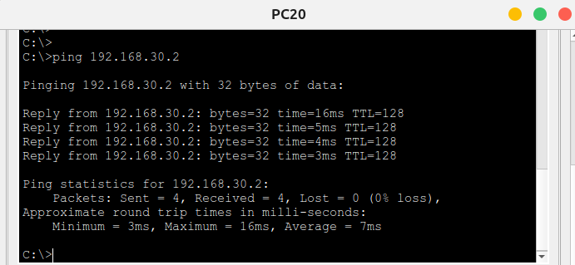
Brisbane Branch - Local
Sales and HR over IPv4
PC20 LAPTOP20

Slide 26
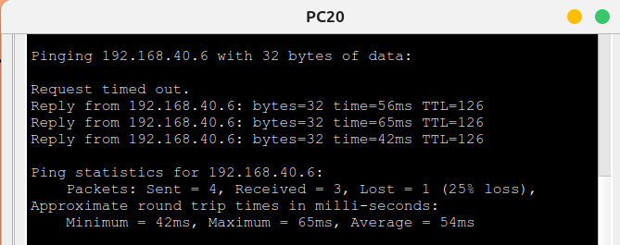
Brisbane Branch - Local
Sales and R+D
HR and R+D over IPv4

Slide 27
Troubleshooting & Testing
WAN

Slide 28
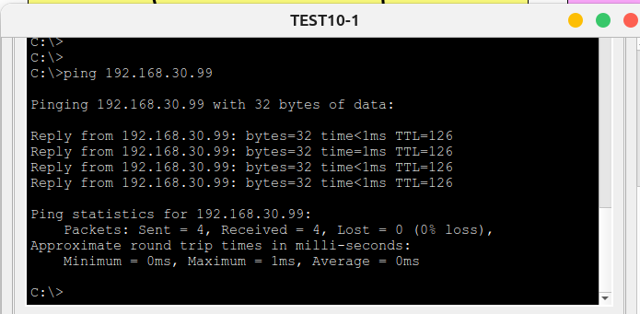
WAN
Sydney Branch and Brisbane Branch over IPv4

Slide 29
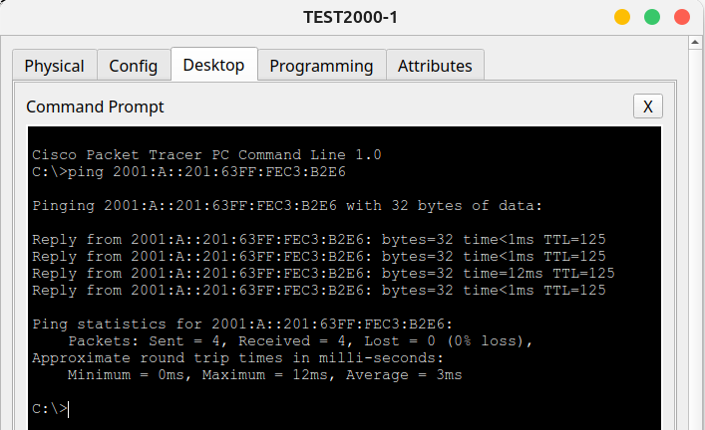
WAN
Brisbane Branch and Sydney Branch over IPv6

Slide 30
Secure Access SSH & Telnet
WAN

Slide 31
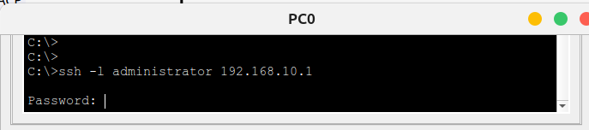
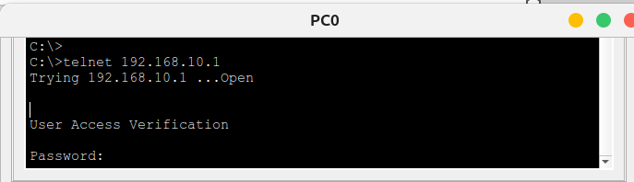
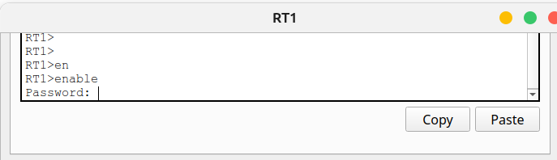
Secure Access
RT1
192.168.10.1

Slide 32
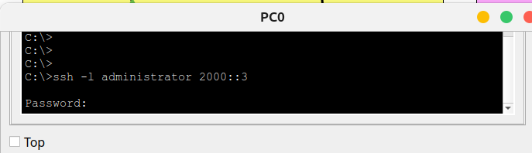
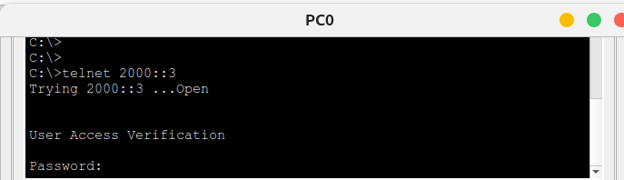
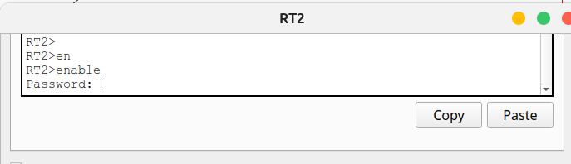
Secure Access
RT2
2000::3

Slide 33
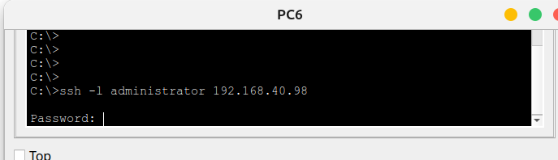
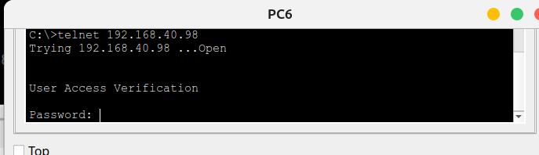
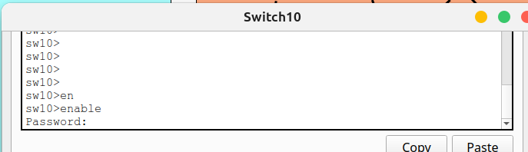
Secure Access
sw10
VLAN1:192.168.40.98

Slide 34
DHCP
WAN

Slide 35
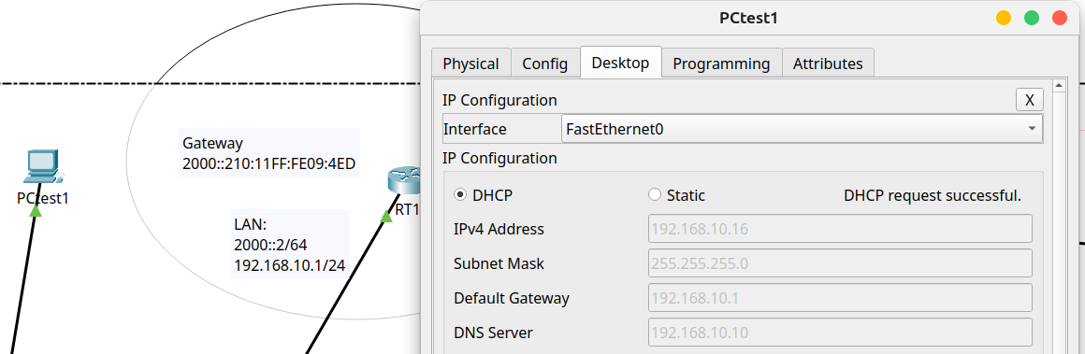
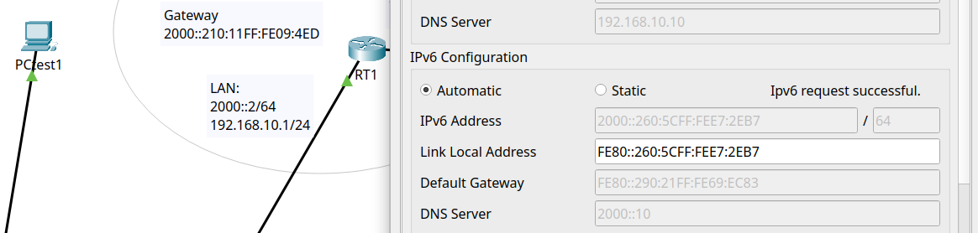
Sydney Branch
RT1
New PC configured to DHCP and IPv6 Auto

Slide 36
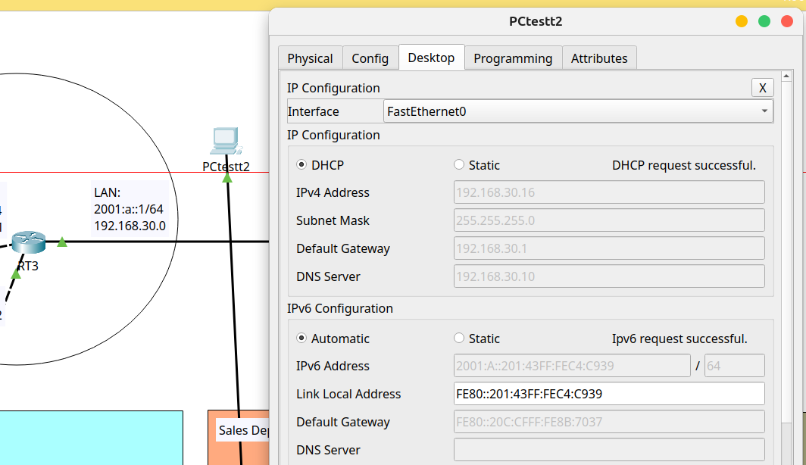
Brisbane Branch
RT3
New PC configured to DHCP and IPv6 Auto

Slide 37
Testing LACP
WAN – IPv6

Slide 38
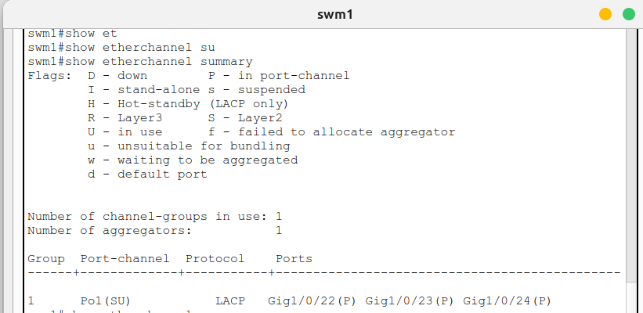
Summary port-channel
Sydney
Summary config

Slide 39
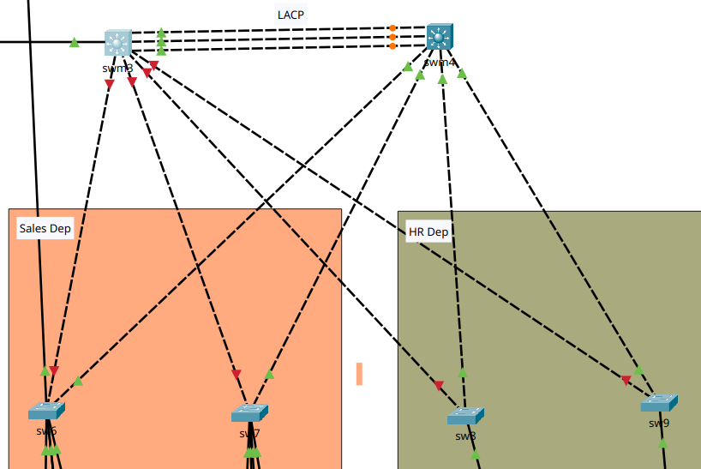
LACP - Brisbane Branch
Turned Down swm3 interfaces

Slide 40
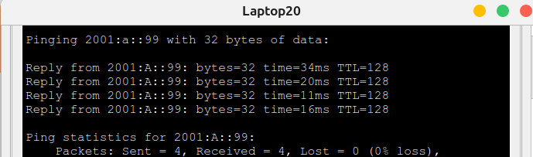
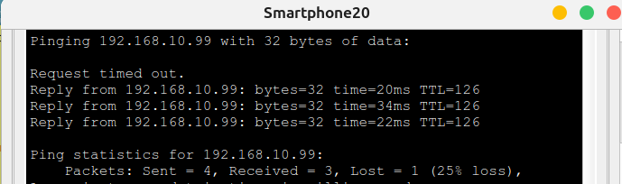
Brisbane Branch
Connections are still working...

Slide 41
Testing HSRP
Sydney – IPv6

Slide 42
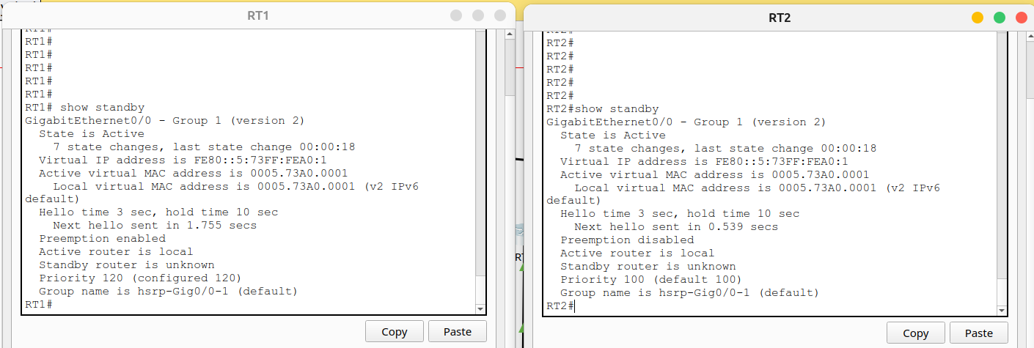
HSRP
Primary (priority 120) and secondary router (priority 100).

Slide 43
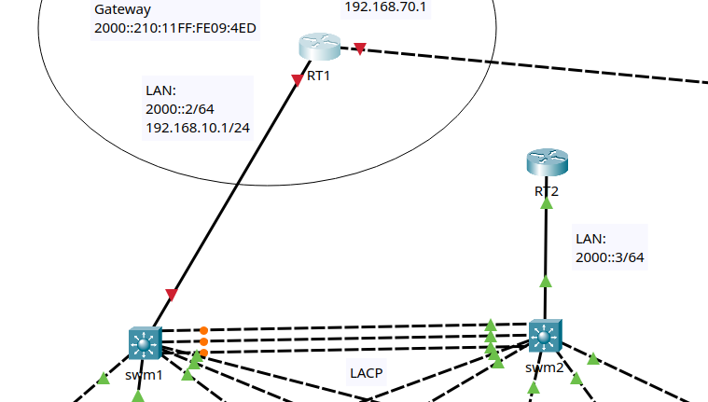
HSRP
The primary router will be turned off to verify network behaviour.

Slide 44
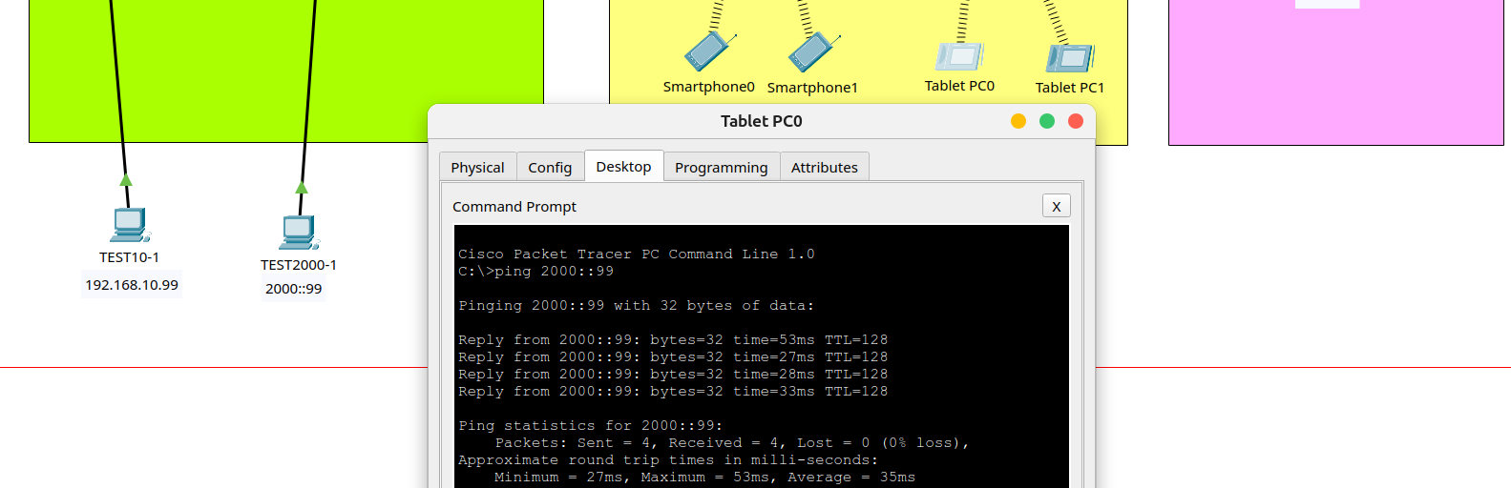
HSRP
RT2 keeps LAN working...

Slide 45
Testing OSPF
WAN

Slide 46
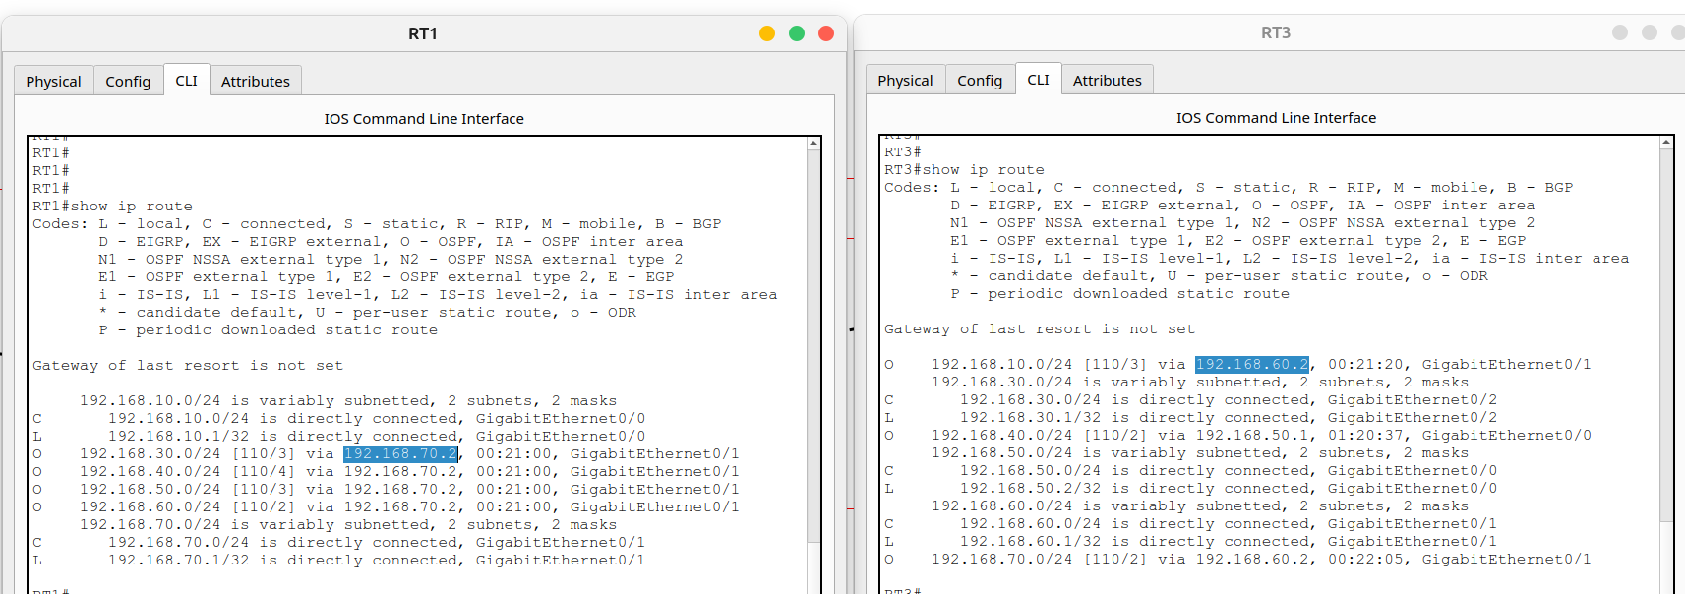
HSRP
Routes between devices are proved by OSPF

Slide 47
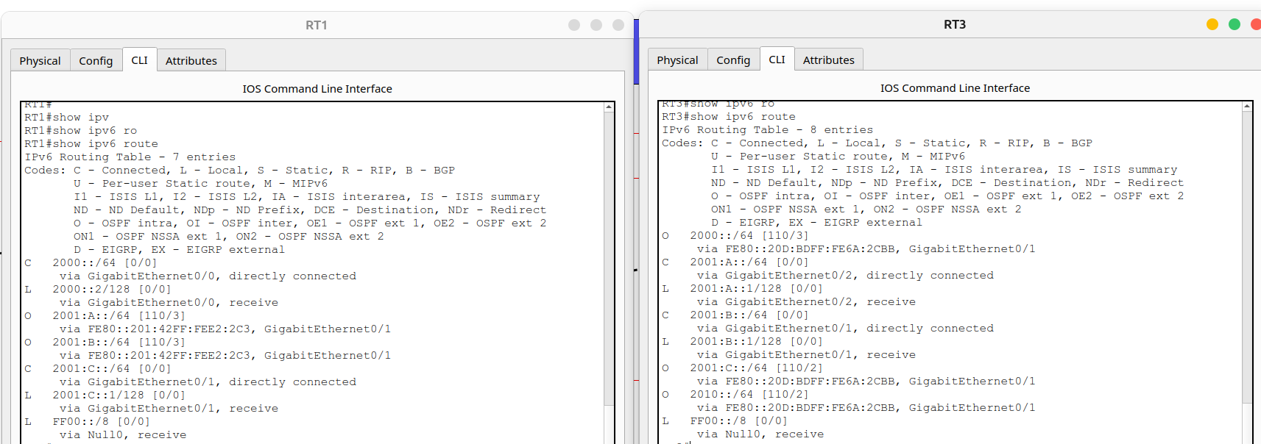
HSRP
Routes between devices are proved by OSPFv3

Slide 48
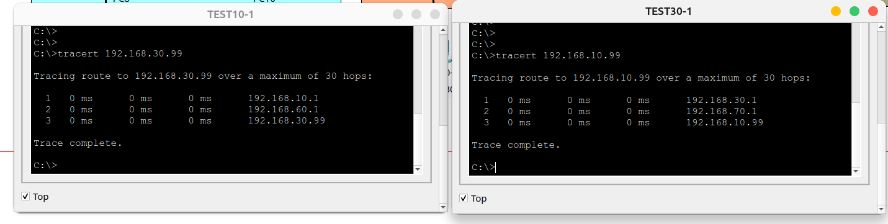
HSRP
Bidirectional trace route between Sydney Branch and Brisbane Branch over IPv4

Slide 49
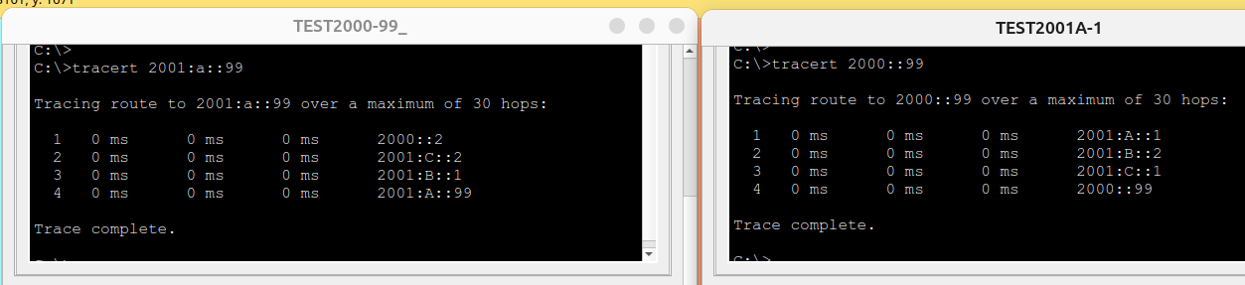
HSRP
Bidirectional trace route between Sydney Branch and Brisbane Branch over IPv6

Slide 50
Testing ACL
WAN – IPv4

Slide 51
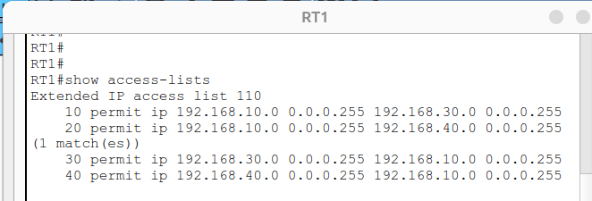
ACL
Example ACL on R1 (Sydney Branch)

Slide 52
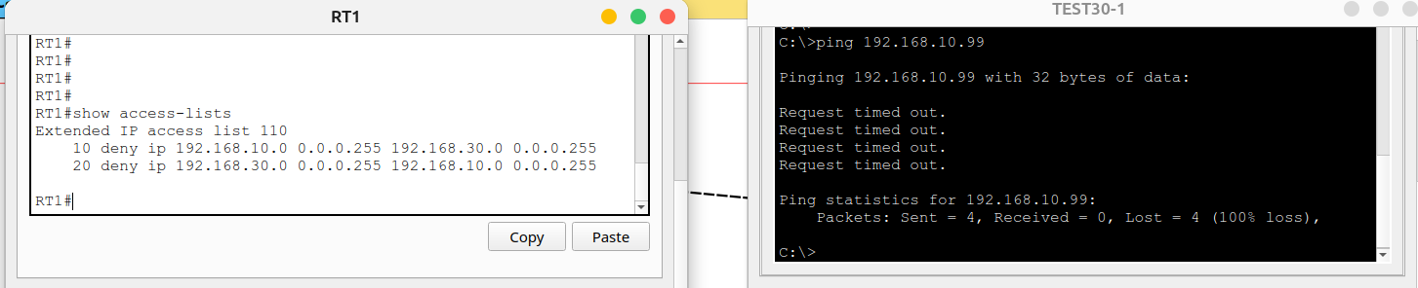
ACL
Deny rule for testing traffic from 192.168.10.99 (Brisbane)

Slide 53
Testing VPN Site-To-Site
WAN – IPv4

Slide 54
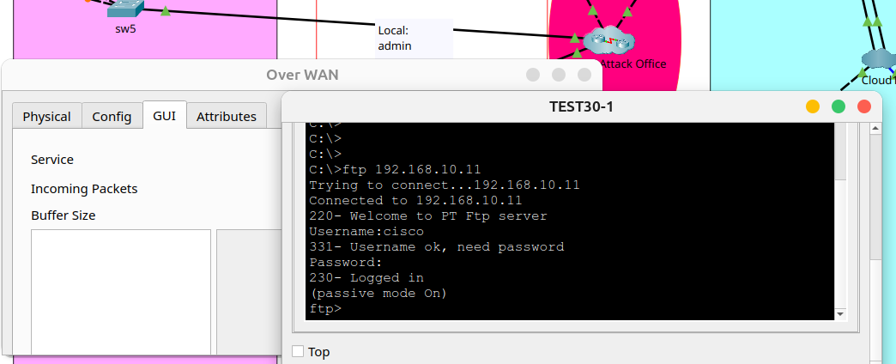
VPN Site-To-Site
Internet connection are intercepted by a criminal sniffer.
FTP Messages cannot be captured.

Slide 55
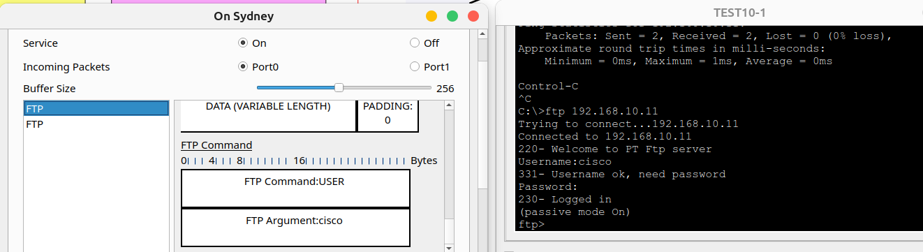
VPN Site-To-Site
Local connection are susceptible to attacks.
FTP Messages can be captured.

Slide 56
Testing Encapsulation PPP
IPv4

Slide 57
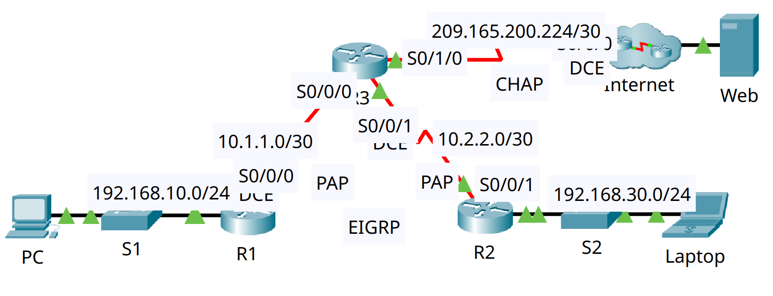
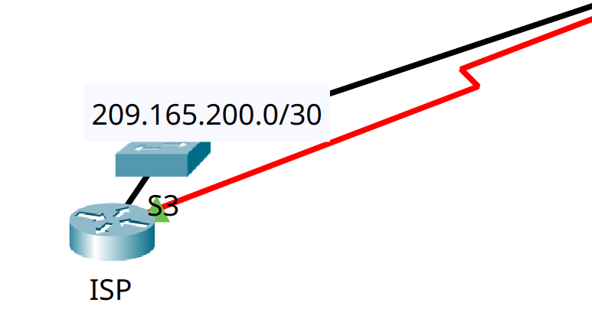
Encapsulation PPP
Implemented CHAP as an automatic authentication method.

Slide 58
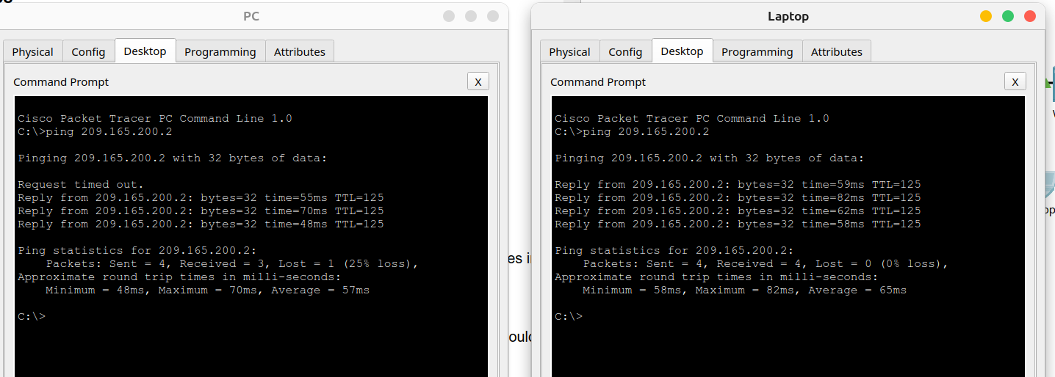
Encapsulation PPP
Connection from Local network to WEB server are working under encapsulation method. CHAP implemented.

Slide 59
Dynamic NAT
IPv4

Slide 60
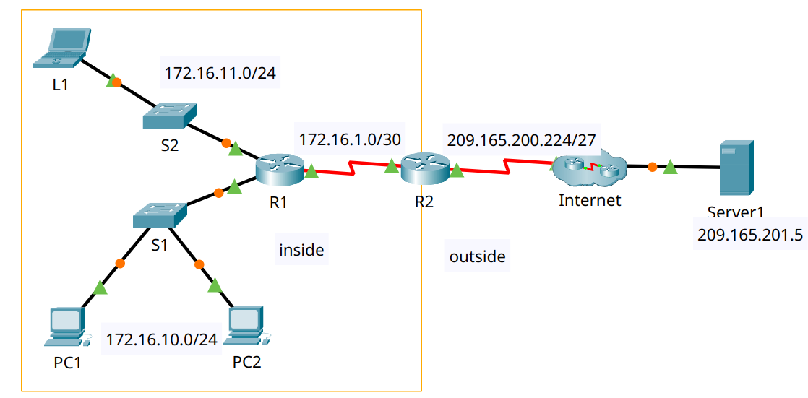
Dynamic NAT
WAN Network

Slide 61
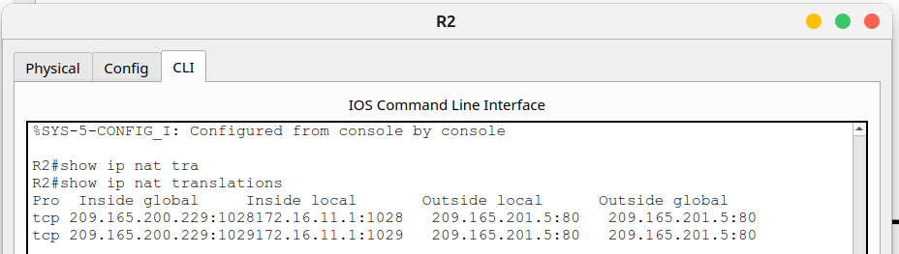
Dynamic NAT
R2 NAT Translations table on

Slide 62
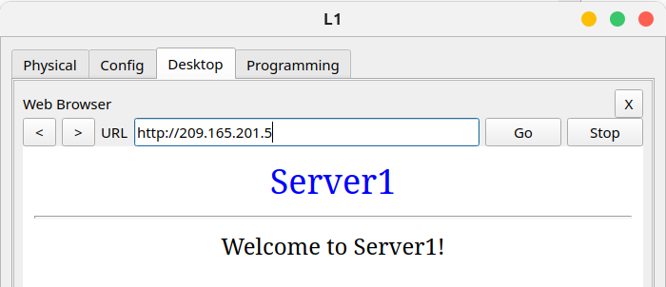
Dynamic NAT
Testing WEB connection

Slide 63
Testing Firewall and Single-port
IPv4

Slide 64
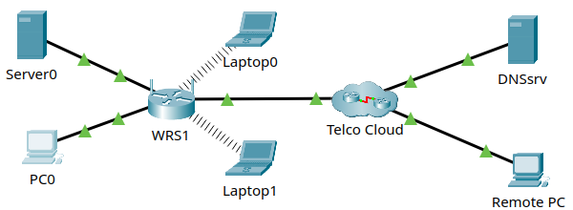
Firewall Single-port
WAN network

Slide 65
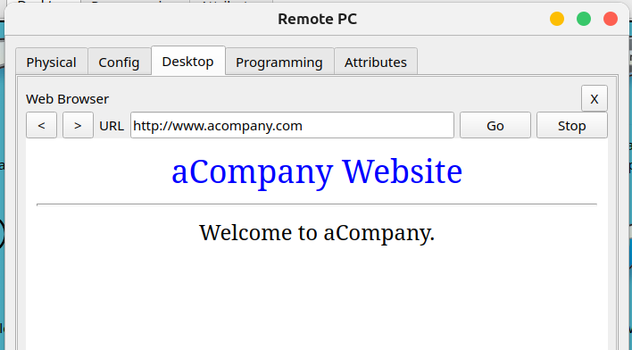
Firewall Single-port
Single-port enabled and DMZ disabled
Connection from Remote PC to WEB Server

Slide 66
Logging Network
IPv4

Slide 67
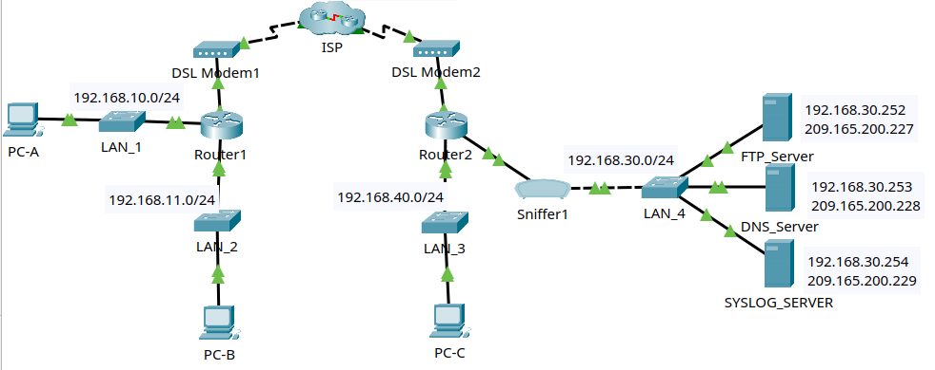
Logging
WAN Network

Slide 68
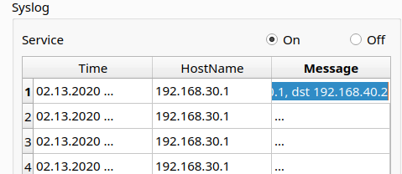
Logging
Echo replies from R2 to PC-C its destination is LAN interface of R2 (because is its local network)

Slide 69
Summary Technologies & Protocols

Slide 70
Summary Technologies
DHCP (Dynamic Host Configuration Protocol):
Automatically assigns IP, gateway, and DNS addresses to devices on the network
LACP (Link Aggregation Control Protocol):
Combines several physical links to form a single logical link for the purpose of increasing bandwidth also providing redundancy when one of the switches fails.

Slide 71
Summary Technologies
HSRP (Hot Standby Router Protocol):
Provides redundancy. If the primary router fails, another router automatically takes over, ensuring service continuity.
OSPF (Open Shortest Path First):
Dynamic routing that allows the calculation of the most efficient route to send packets in a network.

Slide 72
Summary Technologies
ACLs (Access Control Lists):
Rules applied to allow or deny traffic. They are used to filter traffic and improve security.
VPN IPsec (Internet Protocol Security):
Creates secure (encrypted) connections over the Internet between two networks (site-to-site), protecting data confidentiality and integrity.

Slide 73
Summary Technologies
PPP Authentication (Point-to-Point Protocol Authentication):
Responsible for establishing point-to-point connections and provides encapsulation to facilitate the connection. Also supports authentication mechanisms (CHAP) between two network devices to add an additional layer of security.

Slide 74
Summary Technologies
Dynamic NAT (Dynamic Network Address Translation):
Map a public network to multiple private networks on a WAN to communicate with external IPs..

Slide 75
Bibliography
Network System: Gurutech Networking Training - Secure Network Training
DHCPv6 Router: Gurutech Networking Training - DHCPv6
DHCPv6 stateless-stateful: ShefferKimanzi - DCHP v6 configuration
LACP: ITExamAnswers.net - Configure EtherChannel l
HRSP v2 IPv6: Packet Tracer Network - HSRP Configuration
IPCisco.com: ADSL IPv6
ACLs: Packet Tracer Network - ACLs
OSPFv3: Networking Academy - IPv6 OSPFv3
OSPf: Computer Networking - OSPF
VPN IPsec tunnel (site-to-site): Abdullah Irfan, Medium, VPN tunnel
VPN site-to-site, IPsec: Gurutech Networking Training - VPN IPsec
SSH: Sheffer Kimanzi, Configuring ssh
Telnet: Sheffer Kimanzi, Configuring telnet
Dynamic NAT: ComputerNetworkingNotes - Dynamic NAT

Slide 76


